Slide 1
GENDER EQUALITY AND WOMEN’S EMPOWERMENT IN INDIA
Analysis of data from the 2005-06 National Family Health Survey

Slide 2
Report Objective
How far has India progressed toward the twin goals of gender equality and women’s empowerment?

Slide 3
To answer this question, the report provides information on the following topics:
Son Preference
Education
Marriage and spousal age difference
Employment
Female household headship
Access to resources
Gender relations
Decisionmaking
Spousal violence
Gender and health and nutrition outcomes for children and adults
© 2003 Pritam Kumar Nanda/CARE India, Courtesy of Photoshare
Notes:
The report covers all of these topics to provide insight into India’s progress toward meeting the twin goals of gender equality and women’s empowerment

Slide 4
Son Preference
Son preference is a fundamental measure of gender inequality. Son preference:
Affects the likelihood of a girl being born.
For girls who are born, it affects the likelihood that they will survive.

Slide 5
Trend data provides strong evidence of declines in the sex ratio of the population age 0-6 and the sex ratio at birth….
…females are under-represented among births and over-represented among births that die.

Slide 6
Sex ratios at birth for completed pregnancies in the five years preceding NFHS-3
Ultrasound tests are being widely used for sex selection
Sex selection is more evident for pregnancies to the most wealthy women than to women in the other wealth quintiles.
Notes:
Normal sex ratios between 943 and 971

Slide 7
After the first month of life, girls are more likely to die than boys: The child mortality rate is 61% higher for girls than for boys.

Slide 8
Contents
Son Preference
Education
Marriage and spousal age difference
Employment
Female household headship
Access to resources
Gender relations
Decisionmaking
Spousal violence
Gender and health and nutrition outcomes for children and adults
© 1995 Kathryn Wolford/Lutheran World Relief, Courtesy of Photoshare

Slide 9
Percentage of boys and girls attending school in the 2005-06 school year
Two-thirds of girls and three-fourths of boys age 6-17 years are attending school.
The sex ratio of children attending school is only 889 girls per 1,000 boys.

Slide 10
Percentage of boys and girls attending school in the 2005-06 school year
There is gender equality in school attendance in urban areas; but, in rural areas, the female disadvantage in education is marked and increases with age.
School dropout beyond primary school is a major problem among both girls and boys.
Urban
Rural

Slide 11
41% of women and 18% of men age 15-49 have never been to school.
Educational attainment remains very low: Even among those age 20-24, only 27% of women and 39% of men have completed at least 10 years of education.
However, the proportion with 10 or more years of education is much higher among younger cohorts than older cohorts.

Slide 12
Contents
Son Preference
Education
Marriage and spousal age difference
Employment
Female household headship
Access to resources
Gender relations
Decisionmaking
Spousal violence
Gender and health and nutrition outcomes for children and adults
© 2000 Todd Shapera, Courtesy of Photoshare

Slide 13
Marriage
The median age at marriage for women age 25-49 is only 16.8 years, about six years lower than the median age at marriage for men (22.7).
In the 13 years since NFHS-1
the median age at marriage among women age 25‑49 has risen by less than one year.
However, there has been a one-third decline in the proportion of women age 20-24 married before age 15.

Slide 14
Contents
Son Preference
Education
Marriage and spousal age difference
Employment
Female household headship
Access to resources
Gender relations
Decisionmaking
Spousal violence
Gender and health and nutrition outcomes for children and adults
© 2002 Melissa May, Courtesy of Photoshare

Slide 15
Percentage of women employed in the 12 months before the survey
Women age 15-49 are about half as likely as men age 15-49 to be employed: 43% vs. 87%.
Women in rural areas are more likely than women in urban areas to be employed; but the reverse is true for men.
Uneducated women are more likely to be employed than educated women.
Years of Education

Slide 16
Employment
Most employed women work for someone else, away from home, and continuously throughout the year; about one in three women do not receive monetary compensation for their work or receive at least part of their payment in kind.
The relationship of employment and wealth for women suggests that, for many women, employment is largely a result of economic necessity.
Marriage is negatively associated with a woman’s likelihood of being employed and is positively associated with a man’s likelihood of being employed.

Slide 17
Trends in the percentage of ever-married women age 15-49 who have been employed in the 12 months preceding the survey according to the characteristics of employment show a steady but very slow increase in women’s employment.

Slide 18
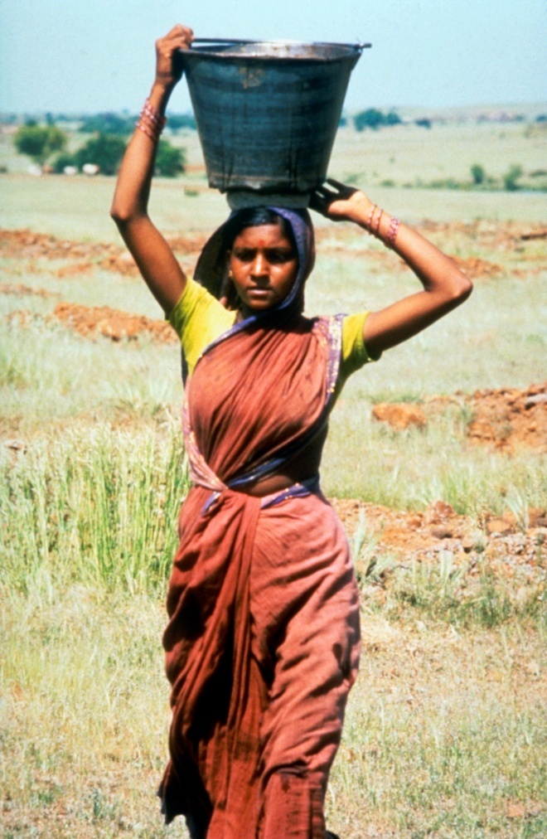
Contents
Son Preference
Education
Marriage and spousal age difference
Employment
Female household headship
Access to resources
Gender relations
Decisionmaking
Spousal violence
Gender and health and nutrition outcomes for children and adults
© 1995 Gene Thiemann/Lutheran World Relief, Courtesy of Photoshare

Slide 19
Trends in the percentage of households headed by females
In the 13 years between NFHS-1 and NFHS-3, the proportion of households with a woman designated as the household head has risen by more than half, from 9% to 14%.

Slide 20
Percent distribution of households headed by males and households headed by females by wealth quintile
Female-headed households are over-represented in the lower wealth quintiles and under-represented in the highest wealth quintiles.
The findings suggest that female-headed households are more economically vulnerable than male-headed households.

Slide 21
Contents
Son Preference
Education
Marriage and spousal age difference
Employment
Female household headship
Access to resources
Gender relations
Decisionmaking
Spousal violence
Gender and health and nutrition outcomes for children and adults
© 2006 Anil Gulati, Courtesy of Photoshare

Slide 22
Sex ratio (females per 1,000 males) of the de facto household population by wealth quintile
Since women are over-represented in the lower wealth quintiles and under-represented in the higher wealth quintiles, women have lower per capita resource access than men.
An examination of sex ratios of children shows that boys are more likely than girls to be growing up in wealthier households.

Slide 23
Access to Resources: Other Findings
Women have lower access to media than men in every age group.
Women’s freedom of movement is severely curtailed: only one in three are allowed to go alone to the market, the health centre, and outside the community.
A majority of women do not have any money of their own that they can use as they wish.
Less than one in six women have a bank or savings account that they use.

Slide 24
Contents
Son Preference
Education
Marriage and spousal age difference
Employment
Female household headship
Access to resources
Gender relations
Decisionmaking
Spousal violence
Gender and health and nutrition outcomes for children and adults
© 2000 Todd Shapera, Courtesy of Photoshare

Slide 25
Percentage of women and men age 15-49 who agree with wife beating by reason
More than half of women and men agree with one or more reasons that justify wife beating.
Both are most likely to agree that wife beating is justified if a woman disrespects her in-laws and if she neglects the house or children.
More than half of women agree with one or more reasons for wife beating in 19 states and more than half of men do so in 15 states.

Slide 26
Percentage of women and men age 15-49 who agree with all three reasons for a wife to refuse her husband sex
The majority of women and men reject the norm that a wife should not refuse her husband sex for any reason.
Notably, more than three in four also agree that a wife is justified in refusing her husband sex if she is tired or not in the mood.

Slide 27
Contents
Son Preference
Education
Marriage and spousal age difference
Employment
Female household headship
Access to resources
Gender relations
Decisionmaking
Spousal violence
Gender and health and nutrition outcomes for children and adults
© 2000 Todd Shapera, Courtesy of Photoshare

Slide 28
Percentage of currently married women age 15-49 who usually make specified decisions alone or jointly
Women have only limited control over household decisions: Less than two in three currently married women participate in various household decisions.

Slide 29
Contents
Son Preference
Education
Marriage and spousal age difference
Employment
Female household headship
Access to resources
Gender relations
Decisionmaking
Spousal violence
Gender and health and nutrition outcomes for children and adults

Slide 30
Percentage of currently married women age 15-49 who have experienced spousal violence, according to type of violence
Two in five currently married women age 15-49 have ever experienced spousal violence in their current marriage.
Among women who have ever experienced such violence, more than two in three have experienced violence in the past year.

Slide 31
Spousal Violence
Women who report both physical and sexual violence are more likely to have injuries and experience more severe forms of physical violence than women who have experienced physical but not sexual violence.
Women who make household decisions jointly with their husbands are less likely to experience spousal violence than women who do not.
Higher education and wealth lower women’s risk of spousal violence; and husbands’ consumption of alcohol significantly increases the risk.

Slide 32
There is a very strong intergenerational effect of violence:
--Women are twice as likely to have experienced violence if their mother experienced spousal violence than if she did not. --They are also more likely to experience violence if their husbands’ mother experienced spousal violence than if she did not, although this effect is smaller.
Percent of currently married women who have experienced spousal violence

Slide 33
Contents
Son Preference
Education
Marriage and spousal age difference
Employment
Female household headship
Access to resources
Gender relations
Decisionmaking
Spousal violence
Gender and health and nutrition outcomes for children and adults
© 2005 Dr. Sanjeev Badiger, Courtesy of Photoshare

Slide 34
Girls are somewhat less likely than boys to be fully immunized; and this gender differential has persisted since NFHS-1.
Percentage of children age 12-23 months who are fully immunized

Slide 35
Gender and Full Immunization
The gender differential in full immunization is evident even when mothers’ education and household wealth are controlled for.
Children’s likelihood of being fully immunized increases with mothers’ education; but when a mother is highly educated, girls benefit more than boys.
Having a mother who mainly alone decides the use of her husband’s earnings increases a girl’s but not a boy’s likelihood of being fully immunized.

Slide 36
A mother’s experience of different types of spousal violence lowers the likelihood of both girls and boys being fully immunized; however, the disadvantage is greater for girls than for boys.
Percentage of children age 12-23 months who are fully immunized

Slide 37
Gender and Adult Nutrition
More than one in three women and men age 15-49 are too thin (BMI<18.5).
Among couples, wives are more likely than husbands to be too thin.
Controlling for wealth and education, factors that increase the likelihood of a woman being undernourished:
employment
not having a main say in decisions about large household purchases
experience of spousal physical or sexual violence
However, women who have the main say alone on the use of their earnings are less likely to be too thin than other employed women.

Slide 38
Gender and Current Use of Modern Contraception
Controlling for number of children ever born and other relevant factors, the likelihood of women using a modern contraceptive method is
higher for women who are employed for cash and for women who make decisions mainly alone about large household purchases.
lower for women who experience both spousal physical and sexual violence.

Slide 39
Conclusion
Gender inequality is persistent in every domain examined, and women are disempowered both absolutely and relative to men.
Trend data show that there is some progress toward gender equality and women’s empowerment; but the progress in most areas remains very slow.

